Slide 1
Amazon E-Commerce Product Analysis
Pricing Strategy | Customer Engagement | Product Performance
Prepared by: Group 3

Slide 2




Project Overview
Cleaned and prepared Amazon product dataset
Performed exploratory data analysis (EDA)
Created visualizations to identify trends
Generated business insights

Slide 3
Objective: Identify key drivers of product popularity and satisfaction
Dataset: 1,465 Amazon product records
Focus Areas:
Pricing Strategy
Customer Engagement
Customer Satisfaction
Product Performance

Slide 4
1. Data Cleaning and Preparation
Ensures reliable, bias-free, and analyzable data
Removed irrelevant columns
Converted price and rating fields to numeric format
Dropped missing values (rating & rating_count)
Removed duplicate records
Engineered new features (discount_amount, review_word_count)
Extracted main_category from hierarchical categories
To ensures reliable, bias-free, and analyzable data

Slide 5
2. Exploratory Data Analysis (EDA)
Ensures reliable, bias-free, and analyzable data
To explore data patterns, distributions, and relationships before drawing strategic conclusions.
Relationship Between Discounts, Ratings, and Customer Behavior
We examined whether pricing incentives and customer feedback influence product popularity and satisfaction.
Conclusion:
Customer engagement is not strongly driven by discounts or ratings alone.
Popularity and satisfaction appear to depend more on product usefulness and real customer demand rather than simple pricing or review metrics.

Slide 6
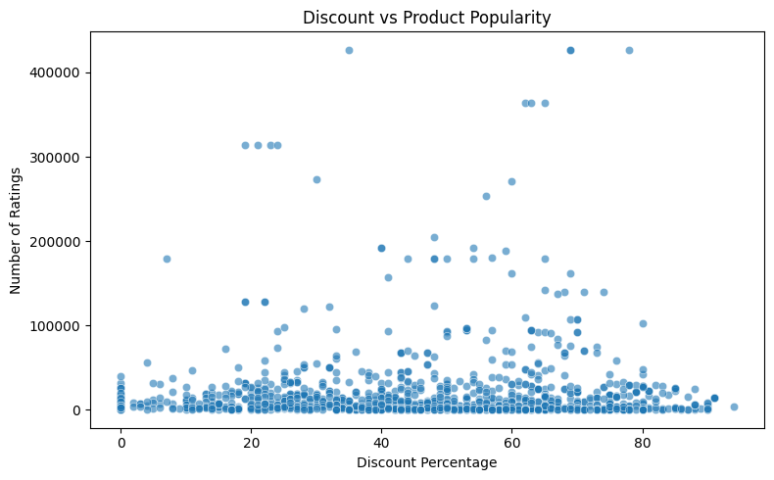
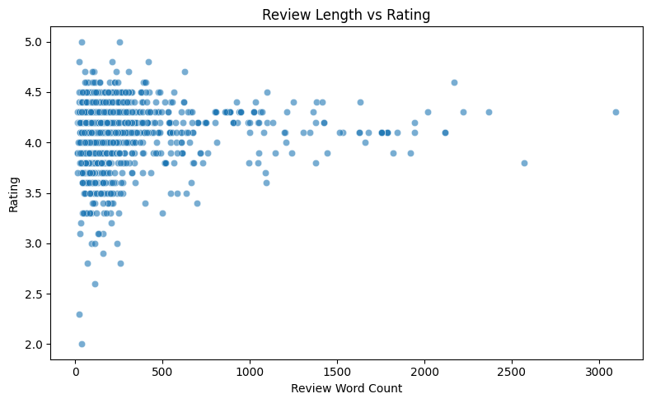
3. Visualization
Key Insight:
Discounts show little impact on popularity. Large price cuts don’t guarantee more ratings or engagement
Popularity is likely driven by product relevance rather than promotions.
Key Insight:
Longer reviews are not strongly associated with higher or lower ratings.
Review length reflects customer involvement, not necessarily satisfaction.

Slide 7
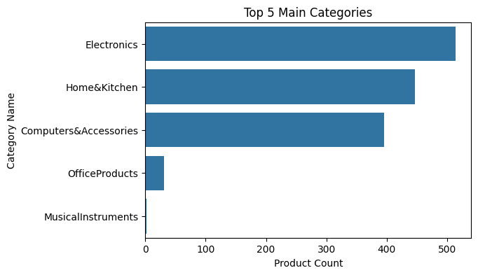
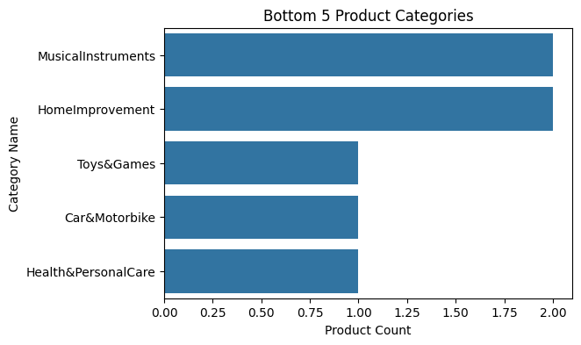
...con’t
Key Insight:
Certain categories dominate the mix.
Market competition is likely higher in dominant categories.
Category concentration suggests tailored strategies are needed per segment.
Key Insight:
Low product volume
Lower competition
Potential for focused growth

Slide 8
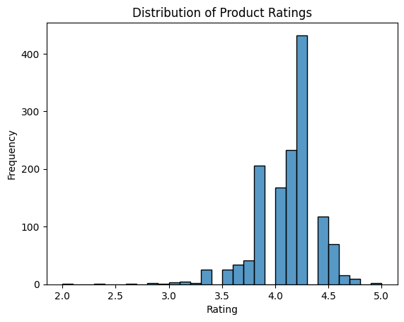
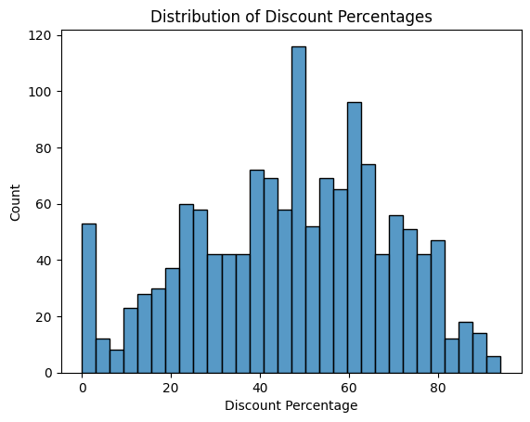
...con’t
Key Insight:
Discounts cluster around moderate ranges, with fewer extreme promotions.
Balanced discounting is common, but extreme discounts are rare and not necessarily effective.
Key Insight:
Most products have high ratings.
Very low-rated products are rare.
Customer satisfaction overall appears positive. which shows strong product quality control

Slide 9
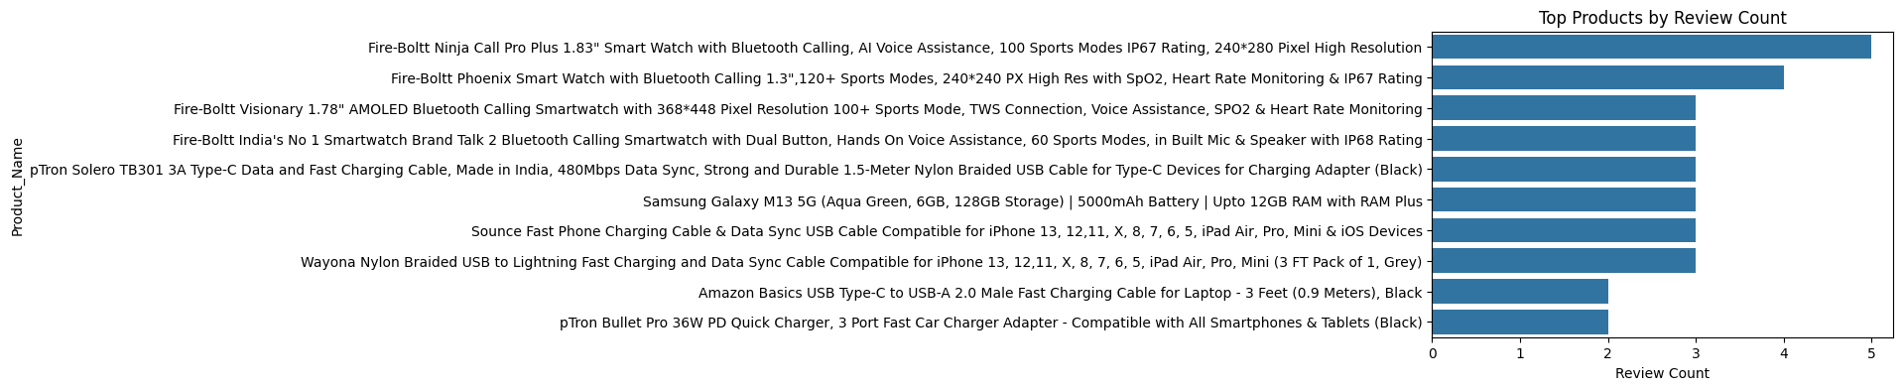
...con’t
Key Insight:
A small number of products account for the majority of reviews.
Engagement is concentrated in a few items.
A few products drive most customer attention, so strategic focus on high-performing items is critical

Slide 10
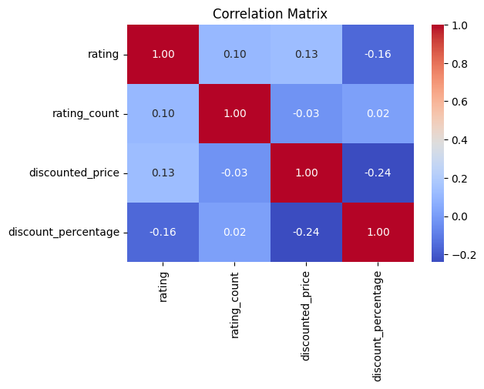
...con’t
Key Insight:
Weak correlations across discounts, ratings.
No single metric dominates
product performance is multifactorial.

Slide 11
4. Recommendations
5. Executive Summary
Focus on product relevance Over Discounting
Leverage High-Performing Products
Optimize Category-Level Strategy
Demand alignment, not discount competition alone.
Use Data-Driven Performance Monitoring
Product success is demand-driven rather than discount-driven.
Customer satisfaction is generally high across products.
Popularity depends on multiple factors beyond price and ratings.
Strategic pricing and product relevance are key growth levers.

Slide 12
Thank you!

